Slide 1

INSTITUTE: UIE (AIT-CSE)
Computer Networks CST- 335
Elements of transport protocols, connection establishment and release, Handshaking operation.
By : Dr.Monica Luthra(E9836)
DISCOVER . LEARN . EMPOWER

Slide 2

Course Objectives
CO Number | Title | Level
CO1 | To bring together several keys to Computer Network Design and Architecture. | Remember
CO2 | To recognize the key concepts of Internetworking. | Understand
CO3 | To prepare a sample Network via Simulation. | Understand

Slide 3
Course Objectives
CO Number | Title
CO1 | Describe the important networking concepts
CO2 | Understand concept of network reference models and protocols
CO3 | Apply the concepts of routing algorithms on various networks
CO4 | Identify mechanism to handle traffic and control on congestion
CO5 | Identify and understand connection establishment techniques and features

Slide 4
Table of Contents
Elements of transport protocols,
Connection establishment and release
Handshaking operation.

Slide 5
Elements of transport protocols
To establish a reliable service between two machines on a network, transport protocols are implemented, which somehow resembles the data link protocols implemented at layer 2. The major difference lies in the fact that the data link layer uses a physical channel between two routers while the transport layer uses a subnet.
Following are the issues for implementing transport protocols−
Error Control
Flow Control
Connection Establishment/Release
Multiplexing/De multiplexing
Fragmentation and re-assembly
Addressing

Slide 6
Connection establishment and release
Connection Establishment –
1. Sender starts the process with the following:
Sequence number (Seq=521): contains the random initial sequence number generated at the sender side.
Syn flag (Syn=1): request the receiver to synchronize its sequence number with the above-provided sequence number.
Maximum segment size (MSS=1460 B): sender tells its maximum segment size, so that receiver sends datagram which won’t require any fragmentation. MSS field is present inside Option field in TCP header.
Window size (window=14600 B): sender tells about his buffer capacity in which he has to store messages from the receiver.

Slide 7
Sequence number (Seq=2000): contains the random initial sequence number generated at the receiver side.
Syn flag (Syn=1): request the sender to synchronize its sequence number with the above-provided sequence number.
Maximum segment size (MSS=500 B): sender tells its maximum segment size, so that receiver sends datagram which won’t require any fragmentation. MSS field is present inside Option field in TCP header. Since MSS_{receiver} < MSS_{sender}, both parties agree for minimum MSS i.e., 500 B to avoid fragmentation of packets at both ends.

Slide 8
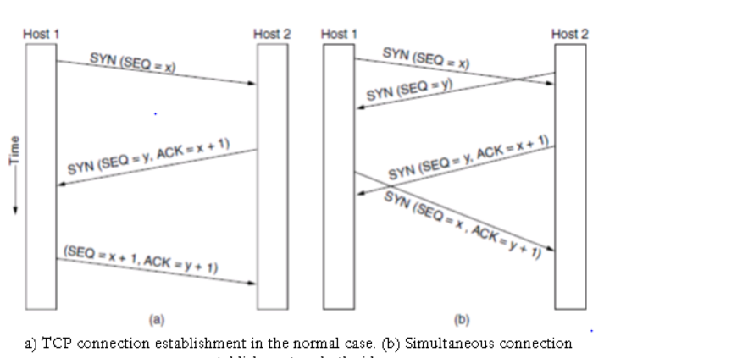

Slide 9
TCP Connection Termination:
TCP provides for a graceful close that involves independent termination of each direction of the connection. A termination is initiated when an application tells TCP that it has no more data to send.
The TCP entity completes transmission of its data and upon receiving acknowledgement from the receiver, issues a segment with the FIN bit set.
Upon receiving a FIN segment, A TCP entity informs its application that the other entity has terminated its transmission of data.
For e.g. as shown in fig below the TCP entity in host A terminates its transmission first by issuing a FIN segment. Host B sends an ACK segment to acknowledge receipt of the FIN segment from A. The FIN segment uses one byte, so the ACK is 5087 as shown in the example.
After B receives the FIN segment, the direction of the flow from B to A is still open. In fig below host B sends 150 bytes in one segment, followed by a FIN segment. Host A then send s an acknowledgment. The TCP in host A then enters the TIME_WAIT state and starts the TIME_WAIT timer with an initial value set to twice the maximum segment lifetime (2MSL).
The only valid segment that can arrive while host A is in the TIME_WAIT state is a retransmission of the FIN segment from host B(if host A’s ACK was lost, and host B’s retransmission time-out has expired).

Slide 10
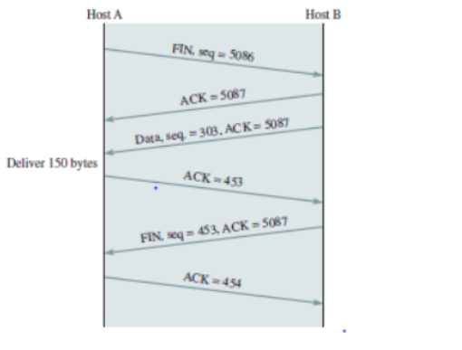
If such a FIN segment arrives while host A is the TIME_WAIT state, then the ACK segment is retransmitted and the TIME_WAIT timer is restarted at 2MSL. When the TIME_WAIT timer expires, host A closes the connection and them deletes the record of the connection.

Slide 11
Handshaking Protocol
The handshake process sets up automated parameters for communication between devices before normal communication begins. Much like the way a human handshake sets the stage for the communication to follow, the computing handshake provides devices with rules for the way data is to be shared between them

Slide 12
How Handshaking Is Used
In order to establish a connection between a computer and a device like a modem, printer, or server, the handshake process begins the connection by telling the devices how to communicate with each other. A classic example is the noises made when two dial-up modems connect to each other. That squealing noise is actually the handshaking procedure. A handshake can also be used between a computer and a printer before printing takes place to tell the printer how to receive and output the data it receives from the computer.

Slide 13
Examples of Handshaking Protocol
While every computer that connects to another one uses handshaking, there are a few examples you use every day. TLS and its predecessor, SSL, or Secure Sockets Layer, use a handshaking procedure when making network connections to verify authorization and protect data between computers. USB connections between devices also use handshakes to verify if data has been received successfully or if the device requires user intervention to continue.
TLS also helps protect against data breaches, as HTTPS has now become standard for websites. For example, larger web browsers like Google have cracked down on non-TLS sites

Slide 14
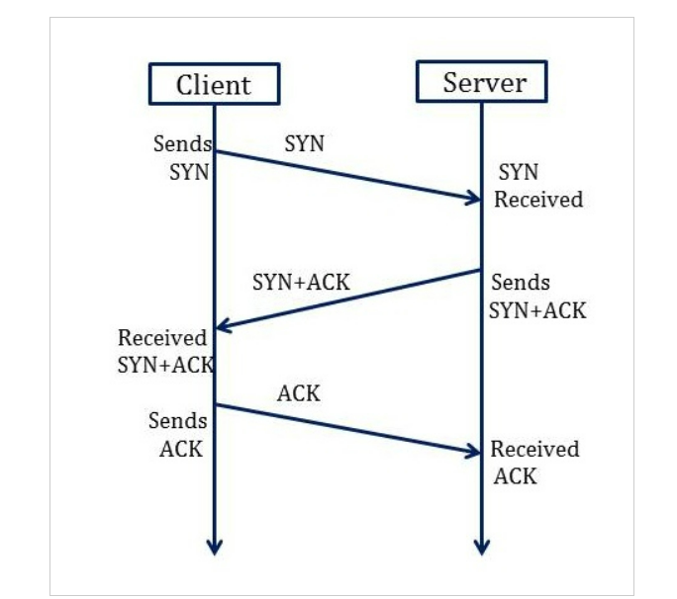
3-Way Handshake Connection Establishment Process
The following diagram shows how a reliable connection is established using 3-way handshake. It will support communication between a web browser on the client and server sides whenever a user navigates the Internet.

Slide 15
Synchronization Sequence Number (SYN) − The client sends the SYN to the server
When the client wants to connect to the server, then it sends the message to the server by setting the SYN flag as 1.
The message carries some additional information like the sequence number (32-bit random number).
The ACK is set to 0. The maximum segment size and the window size are also set. For example, if the window size is 1000 bits and the maximum segment size is 100 bits, then a maximum of 10 data segments can be transmitted in the connection by dividing (1000/100=10).

Slide 16
Synchronization and Acknowledgement (SYN-ACK) to the client
The server acknowledges the client request by setting the ACK flag to 1.
The ACK indicates the response of the segment it received and SYN indicates with what sequence number it will start the segments.
For example, if the client has sent the SYN with sequence number = 500, then the server will send the ACK using acknowledgment number = 5001.
The server will set the SYN flag to '1' and send it to the client if the server also wants to establish the connection.
The sequence number used for SYN will be different from the client's SYN.
The server also advertises its window size and maximum segment size to the client. And, the connection is established from the client-side to the server-side.

Slide 17
Acknowledgment (ACK) to the server
The client sends the acknowledgment (ACK) to the server after receiving the synchronization (SYN) from the server.
After getting the (ACK) from the client, the connection is established between the client and the server.
Now the data can be transmitted between the client and server sides.

Slide 18
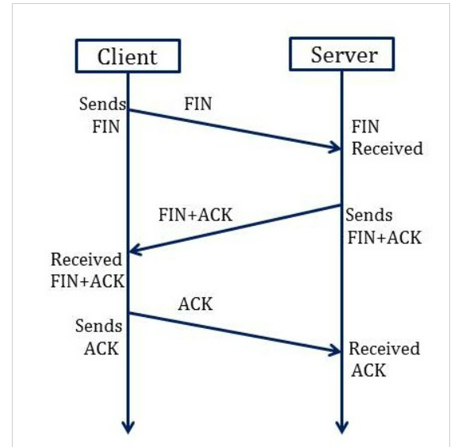
3 -Way Handshake Closing Connection Process
To close a 3-way handshake connection,
First, the client requests the server to terminate the established connection by sending FIN.
After receiving the client request, the server sends back the FIN and ACK request to the client.
After receiving the FIN + ACK from the server, the client confirms by sending an ACK to the server.

Slide 19

References
https://en.wikipedia.org/wiki/Leaky_bucket
https://www.geeksforgeeks.org/leaky-bucket-algorithm/
https://en.wikipedia.org/wiki/Token_bucket
https://www.ques10.com/p/31441/what-is-traffic-shaping-explain-leaky-bucket-algor/

Slide 20
THANK YOU
For queries
Email: monica.e9836@cumail.in

